Slide 1


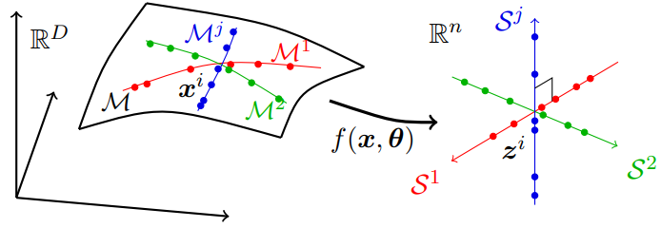
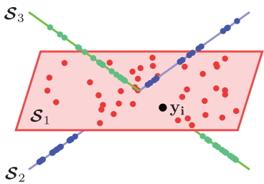
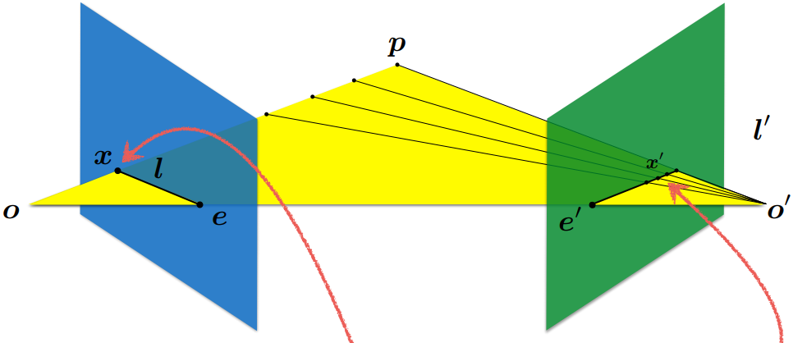

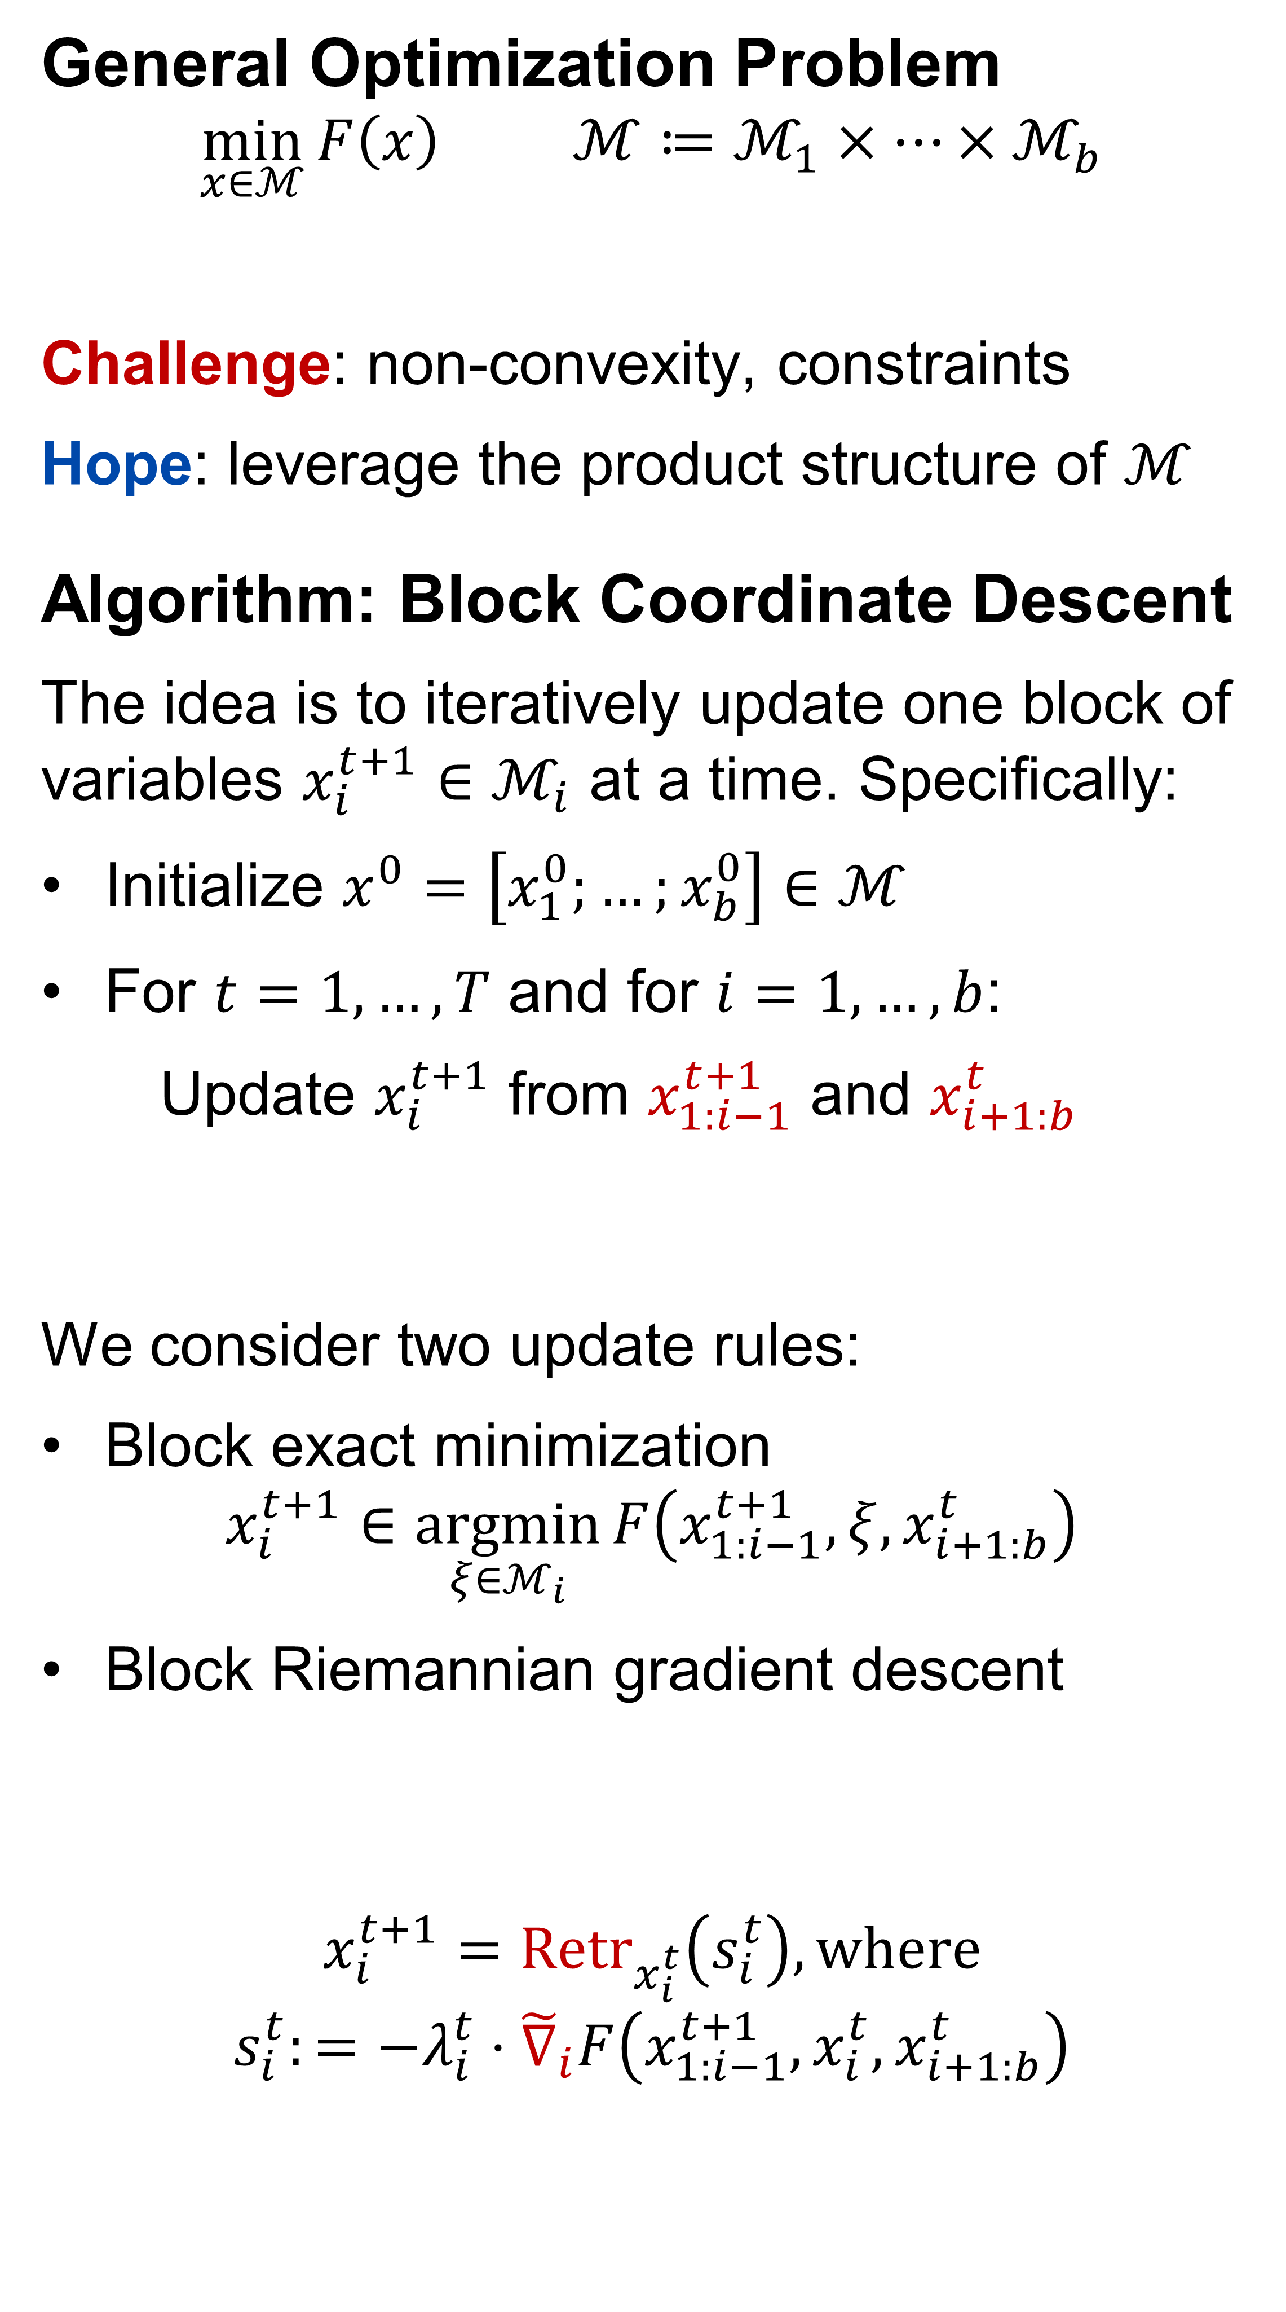
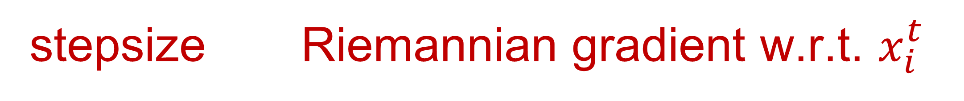
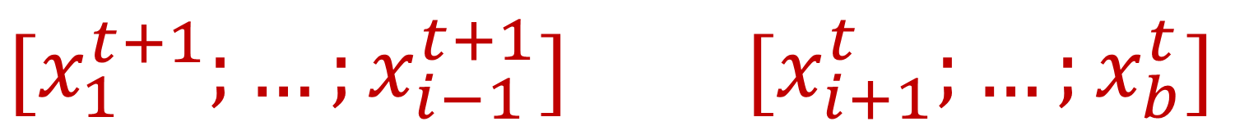

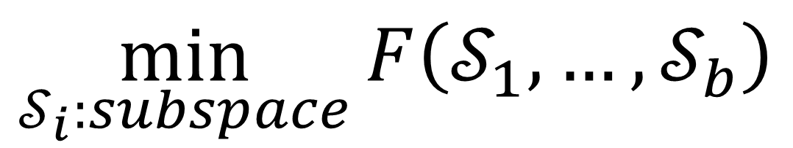


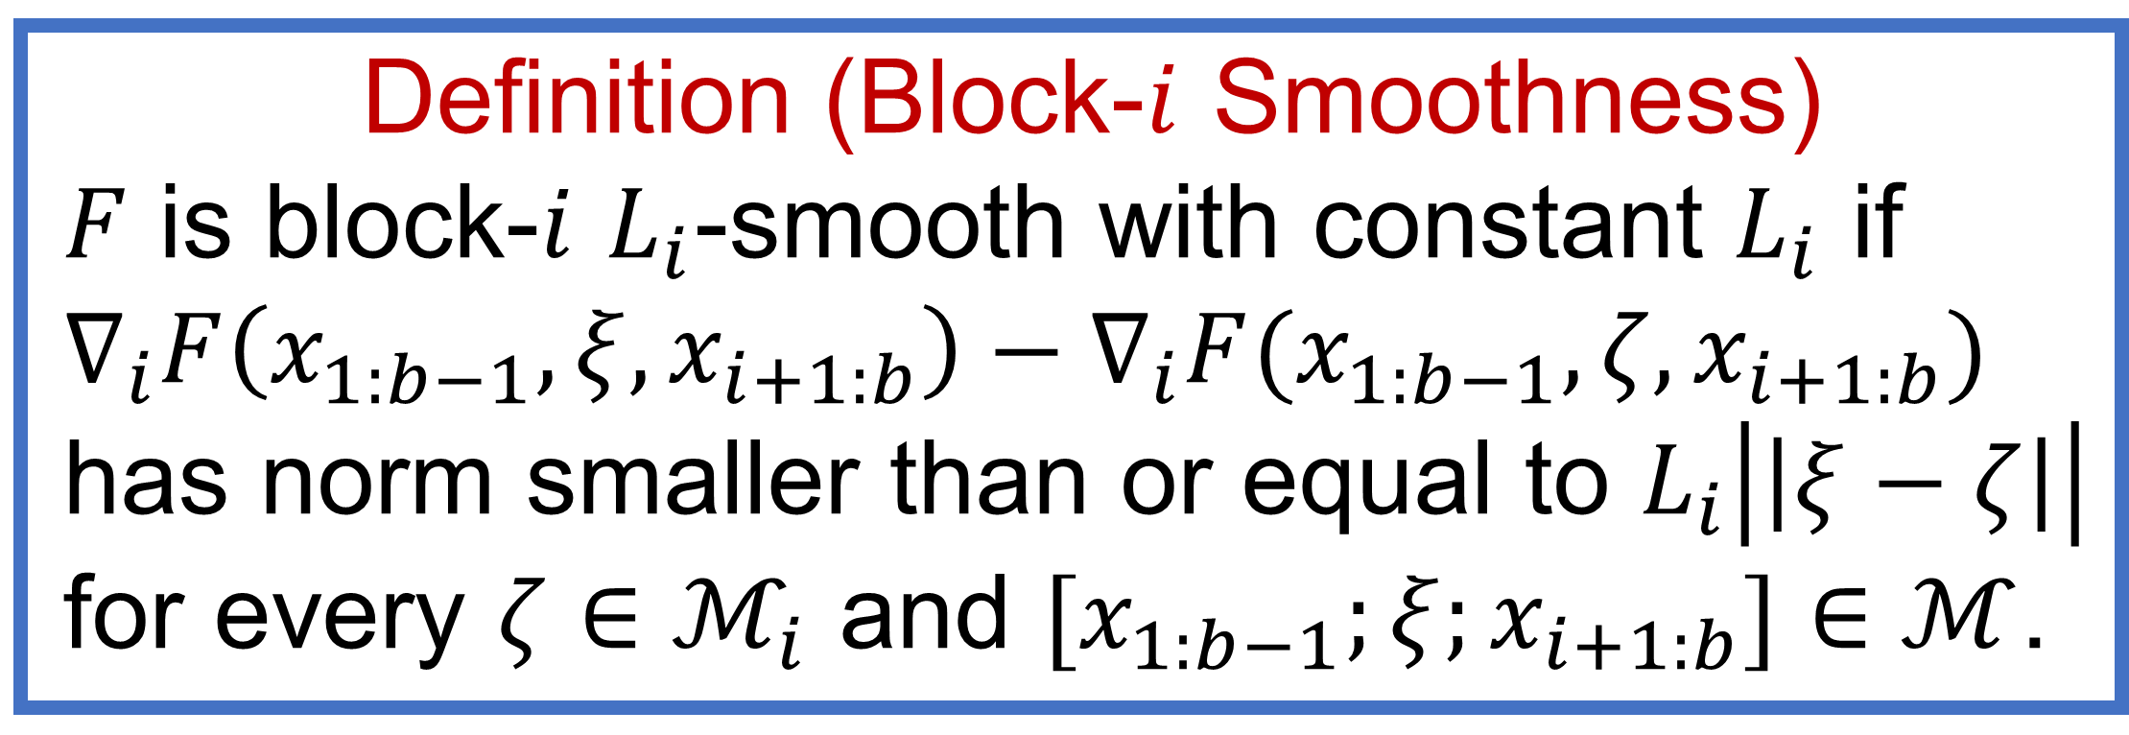
Block Coordinate Descent on Smooth Manifolds
Liangzu Peng René Vidal
Center for Innovation in Data Engineering and Science (IDEAS)
General Optimization Problem
$$\min_{x∈ℳ}{F\left(x\right)} ℳ≔ℳ_{1}×⋯×ℳ_{b}$$
Challenge: non-convexity, constraints
Hope: leverage the product structure of $ℳ$
Algorithm: Block Coordinate Descent
The idea is to iteratively update one block of variables $x_{i}^{t+1}∈ℳ_{i}$ at a time. Specifically:
Initialize $x^{0}=\left[x_{1}^{0};…;x_{b}^{0}\right]∈ℳ$
For $t=1,…,T$ and for $i=1, …, b$:
Update $x_{i}^{t+1}$ from $x_{1:i−1}^{t+1}$ and $x_{i+1:b}^{t}$
We consider two update rules:
Block exact minimization
$$x_{i}^{t+1}∈\underset{ξ∈ℳ_{i}}{argmin}{F\left(x_{1:i−1}^{t+1},ξ,x_{i+1:b}^{t}\right)}$$
Block Riemannian gradient descent
$$x_{i}^{t+1}={Retr}_{x_{i}^{t}}\left(s_{i}^{t}\right), where$$
$$s_{i}^{t}:=−λ_{i}^{t}⋅{\tilde{∇}}_{i}F\left(x_{1:i−1}^{t+1},x_{i}^{t},x_{i+1:b}^{t}\right)$$
Examples
Maximum Coding Rate Reduction
$$\min_{z_{i}∈ℳ}{F\left(z_{1},…,z_{n};x_{1},…,x_{n}\right)}$$
Generalized PCA
Essential Matrix Estimation
$$\min_{E}{{\left(x_{1}^{⊤}Ex_{1}^{′}\right)}^{2}+⋯+{\left(x_{m}^{⊤}Ex_{m}^{′}\right)}^{2}}$$
Here, the essential matrix $E$ is defined by some 3D rotation $R$ and unit vector $t$, i.e.,
$$Ex′≔t×\left(Rx′\right)$$
Convergence Theory
Ongoing Work
Prove stronger convergence guarantees
Discover more applications & examples
Theorem 1 (Asymptotic Convergence)
Assume:
$ℳ_{i}$ is a closed subset of $ℝ^{n_{i}}$ ($∀i$)
Set $\{x:F\left(x\right)≤γ\}$ is bounded ($∀γ∈ℝ$)
Minimizing $F\left(x_{1:i−1},ξ,x_{i+1:b}\right)$ over $ξ∈ℳ_{i}$ has a unique minimizer ($∀x_{j}∈ℳ_{j}$)
Then the sequence ${\left\{x^{t}\right\}}_{t}$ generated by block exact minimization has limit points, and each limit point is a stationary point.
differentiable non-empty
Definition (Block-$i$ Smoothness)
$F$ is block-$i$ $L_{i}$-smooth with constant $L_{i}$ if $∇_{i}F\left(x_{1:b−1},ξ,x_{i+1:b}\right)−∇_{i}F(x_{1:b−1},ζ,x_{i+1:b})$ has norm smaller than or equal to $L_{i}\left|\left|ξ−ζ\right|\right|$ for every $ζ∈ℳ_{i}$ and $[x_{1:b−1};ξ;x_{i+1:b}]∈ℳ$.
$$\min_{𝒮_{i}:subspace}{F\left(𝒮_{1},…,𝒮_{b}\right)}$$
${[x}_{1}^{t+1};…;x_{i−1}^{t+1}]$ ${[x}_{i+1}^{t};…;x_{b}^{t}]$
Theorem 2 (Sublinear Convergence)
Assume ($∀i$):
$F$ is block-$i$ $L_{i}$-smooth with constant $L_{i}$
$ℳ_{i}$ is a compact manifold of $ℝ^{n_{i}}$
Then block exact minimization and block Riemannian gradient descent converge at a sublinear rate: Their iterates ${\left\{x^{t}\right\}}_{t}$ satisfy
$$\min_{t=0,…,T}\left|\left|\tilde{∇}F\left(x^{t}\right)\right|\right|=O\left(\frac{1}{\sqrt{T}}\right).$$
A map from the tangent space $T_{x_{i}^{t}}ℳ_{i}$ to $ℳ_{i}$
stepsize Riemannian gradient w.r.t. $x_{i}^{t}$
Caution: Figures shown above are not original.

